Slide 1
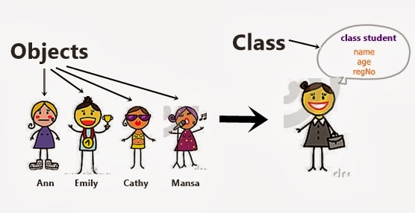
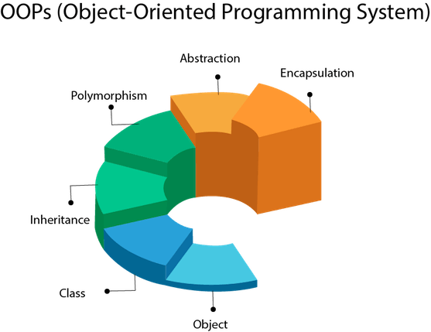
JAVA
Notes:
https://www.softwaretestingmaterial.com/selenium-interview-questions/

Slide 2
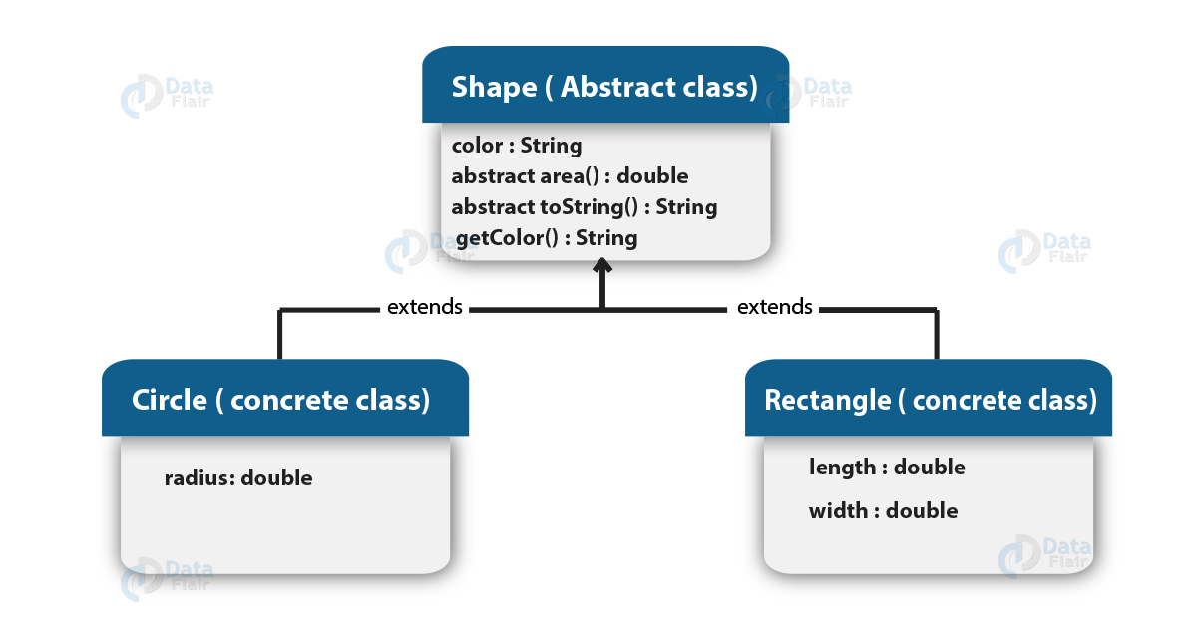
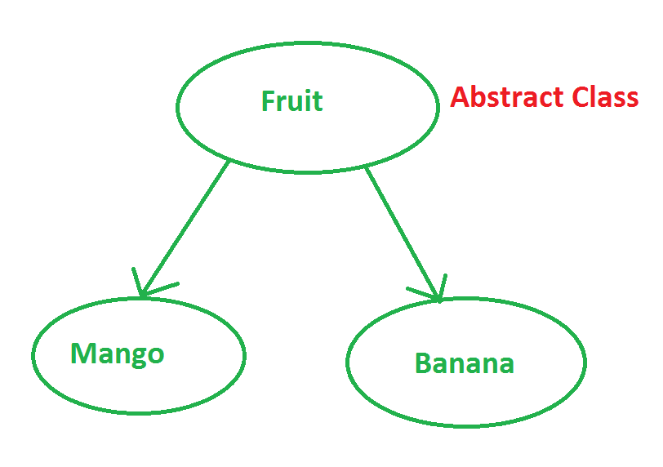
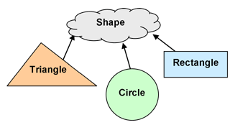
Abstraction
Abstraction means using simple things to represent complexity.

Slide 3
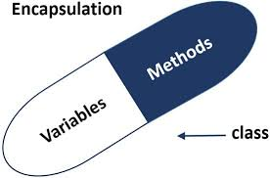
Encapsulation
This is the practice of keeping fields within a class private, then providing access to them via public methods

Slide 4
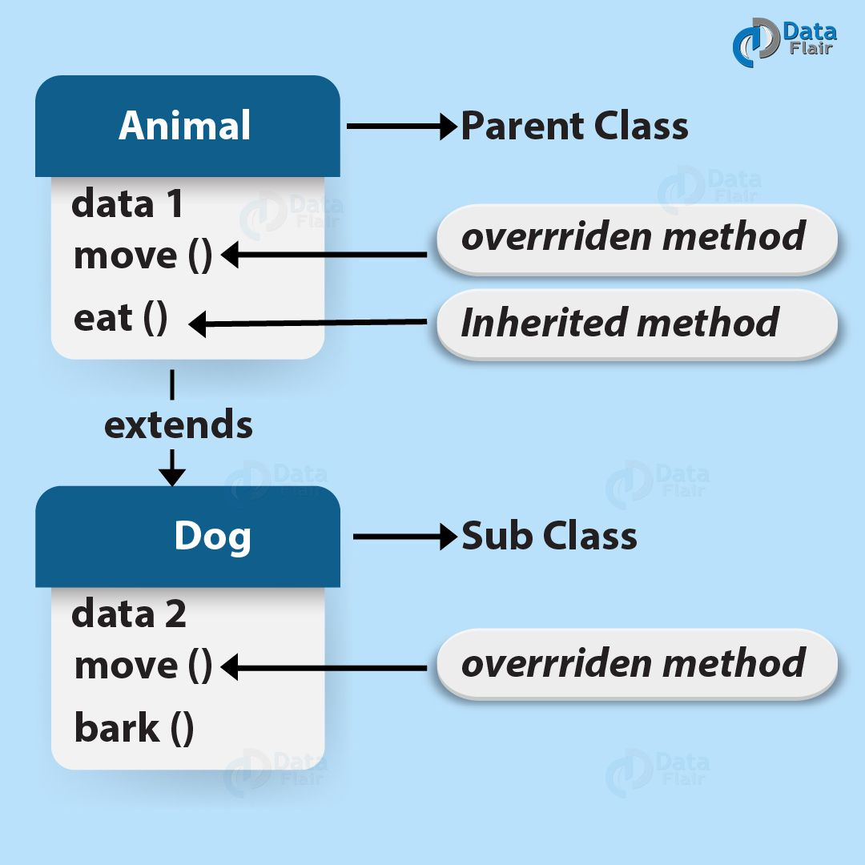
Inheritance
It lets programmers create new classes that share some of the attributes of existing classes.

Slide 5
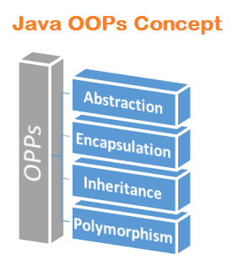
Polymorphism
This Java OOP concept lets programmers use the same word to mean different things in different contexts.

Slide 6
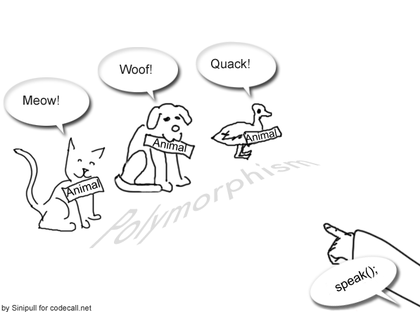
Polymorphism
Method overloading Virtual function
Operator overloading method overriding
Static or Compile Time
Dynamic or Run Time

Slide 7
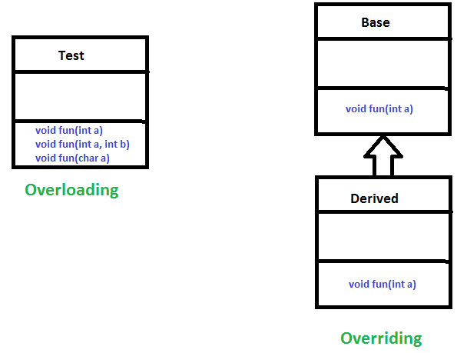
method overloading
a single method name might work in different ways depending on what arguments are passed to it.

Slide 8
method overriding
the child class can use the OOP polymorphism concept to override a method of its parent class.

